Slide 1

Group Presentation for Stock Market Exchange
Project Team
Vuthej Krishna Reddy
Ankita Pandey
Nupur Roy Chowdhury

Slide 2
Group Presentation for Stock Market Exchange
The project consists of stock market data which was taken from ”Yahoo Finance” considering from the year 2014 – 2019 i.e. within a range of 5 years for data exploration.
Project Objective:
Identify the data that we would consider for web scraping.
Identify the parameters based on which we want to prepare and build our datasets
Apply web-scraping to extract that data and display.
Observations and challenges faced while doing the tasks.

Slide 3
Overview
Yahoo Finance is a media property that is part of Yahoo's network.
It provides financial news, data and commentary including stock quotes, press releases, financial reports, and original content. It also offers some online tools for personal finance management.
As of June 2017, Yahoo Finance is part of Oath, the media division of Verizon. It is the largest business news web site in the United States by monthly traffic.

Slide 4
Data Overview:
Data Harvesting was performed on the Yahoo Finance website : https://finance.yahoo.com/ .
Data which was extracted consisted of the below:
  History of share market for the TOP 50 companies in Technological Domain.
  Company details of top 50 companies
  And the extended attributes of the top 50 companies which are considered.
  Eg : Present holdings, Quarterly growth etc.
  Concept of learning:
  Data preprocessing techniques.
  How to do web scraping of the required data from the website
  How to work more with pandas.

Slide 5
Approach
  Yahoo Finance as the source for web-scraping.
  Extract Statistical Data, Historical Data and Profile Data.
  Select top 50 companies with high Market Cap.
  Data to Span over last 5 years.
  Build datasets (CSV and JSON files).

Slide 6
Data preparation :
Data was prepared using Web Harvesting of the “Yahoo Finance” website.
The datasets which were build out of them were:
Stock_Market_Attributes.csv
Statistics.csv
company.csv
Data Cleaning:
While harvesting the data we had cleaned the data in a way where we are scraping out only the related fields and attributes which we require other than the whole website for each and every company.
For Stock_Market_Attributes.csv :
top50_html = requests.get("https://finance.yahoo.com/sector/ms_technology").text
For Statistics.csv:
rp = s.get('https://finance.yahoo.com/quote/{}/key-statistics?p={}’
For company.csv:
crumb_link = 'https://finance.yahoo.com/quote/{0}/history?p={0}'

Slide 7
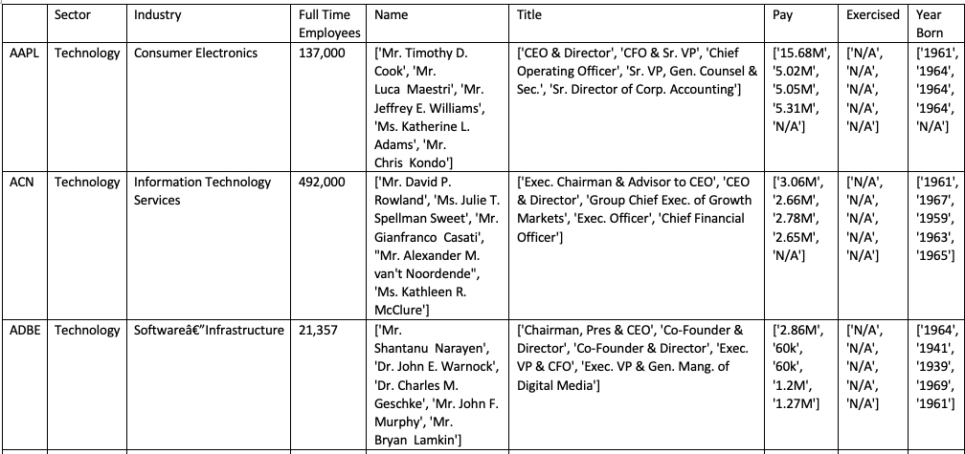
Stock_Market_Attributes.csv

Slide 8
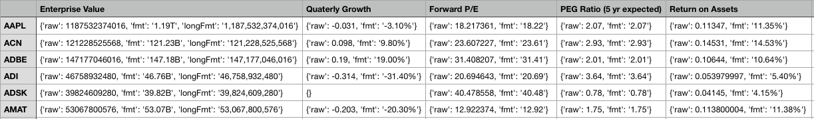
Statistics.csv

Slide 9
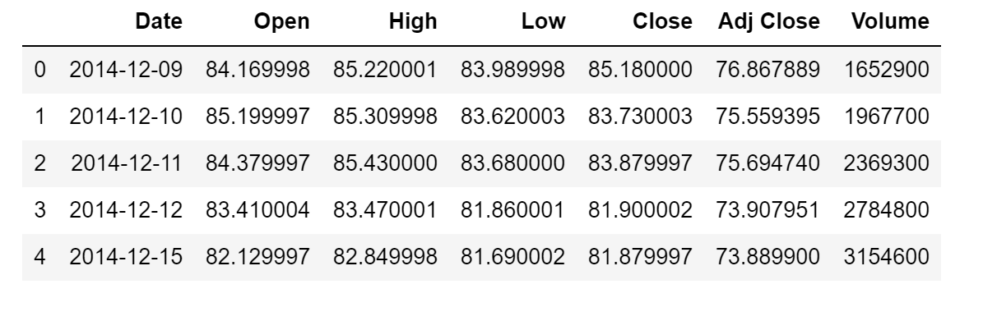
Company.csv

Slide 10
Parameters which have been extracted:
Stock_Market_Attributes.csv 'Sector' 'Industry' 'Full Time Employees' 'Name' 'Title' 'Pay' 'Exercised' 'Year Born' | Company.csv 'Date' 'Open' 'High' 'Low 'Close' 'Adj Close' 'Volume'
Statistics.csv 'Enterprise Value' 'Quarterly Growth' 'Forward P/E' 'PEG Ratio (5 years expected)' 'Return on Assets' 'Quarterly Revenue Growth' 'EBITDA' 'Diluted EPS' 'Total Debt or Equity' 'Current Ratio'

Slide 11
Key points, findings, and/or recommendations:
Extraction was difficult due to complex and changing structure.
Explicit links had to be created in the code for extracting data from the specific company hyperlinks instead of going to the hyperlinks directly.
Few instances of the extracted data has special characters which when stored and build in an excel sheet looks like random characters in the file.
Conclusion/Future Work:
Further attributes can be included in order to enrich the data set which helps in better evaluating and analyzing at the later stage.
Along with additional attributes, additional instances of data can also be added by expanding the scope to other companies.
This can also be integrated with other projects trying to check the stock market price or for projects implementing any specific company details for their project.

